Slide 1
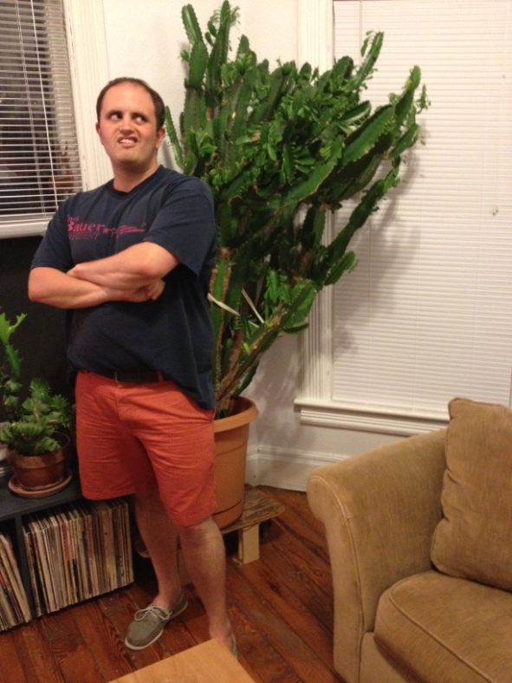
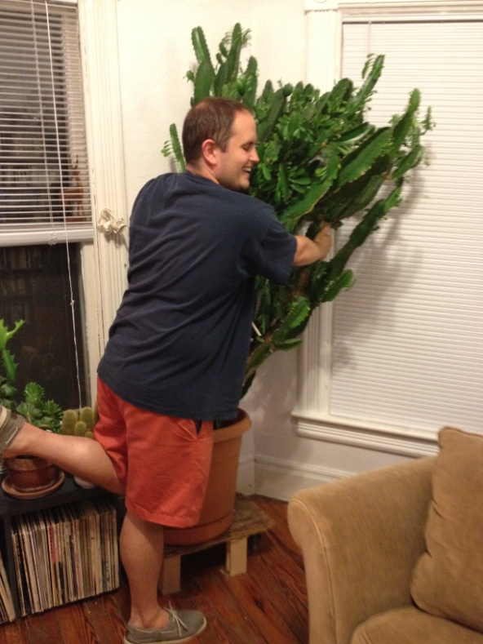
A Less Prickly Cactus
LASSP Theory Pizza Talks, July 19th, 2012 Zach(tus) Lamberty

Slide 2
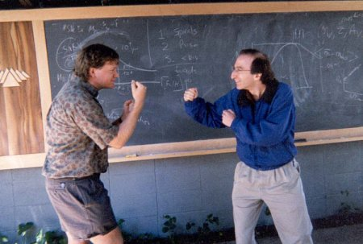
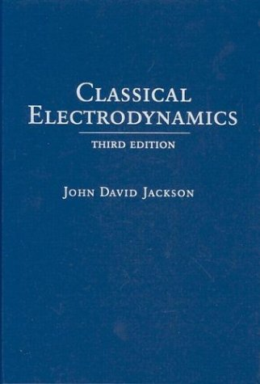
So Frustrating…
???
You
What is frustration?
???
J
(AFM)
Brian Schmidt v. Saul Perlmutter, picture by Nicholas Suntzeff
Research
Life

Slide 3
So Frustrating…
???
Why study it?
Lots of lattices
Weird stuff
Macroscopic ground state degeneracies
“Accidental” symmetries
Quantum Spin Liquid state (avoids magnetic ordering down to T = 0)
Fractional / anyonic excitations
Ground states robust to local perturbation (“Topological” states)
Order by disorder effects
Some real materials: S = 3/2 and 5/2 Jarosites, S = 1/2 Herbertsmithite, S = 3/2 BSZCGO

Slide 4
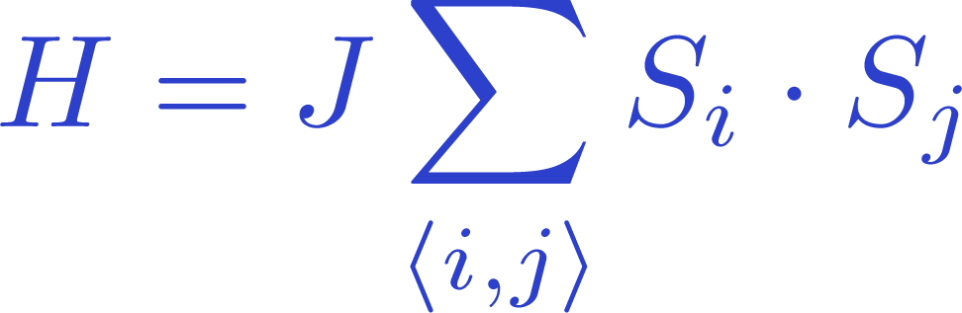
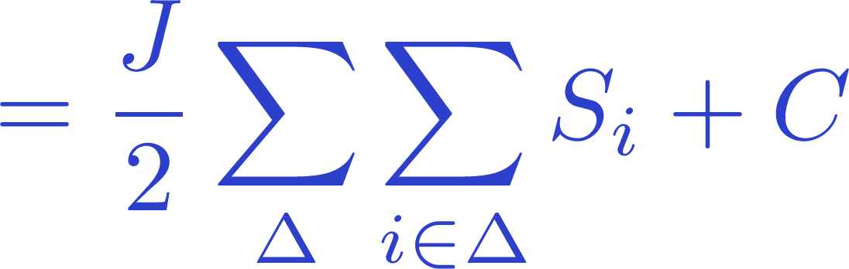
Kagome!
???
Classical Heisenberg AFM ordered
Quantum S = 1/2
No LRO in spin-spin correlation
Rapid decay in higher-order correlations
Very small or no spin gap
Gapless singlet sector
Quantum S = 1
Large spin gap
Quantum S = 3/2
Very small or no spin gap
Not a lot of intuition for any “medium” S, especially S > 1/2!

Slide 5
Kagome!
???
Want large lattice sizes and S > 1/2
ED exponentially difficult (State of the art: 48 sites)
No good way to choose variational wave function for QMC (which also has the sign problem)
Density Matrix Renormalization Group methods… …abhor loops!
DMRG State of the Art: 726-site cylinder, 108-site taurus
m
m

Slide 6
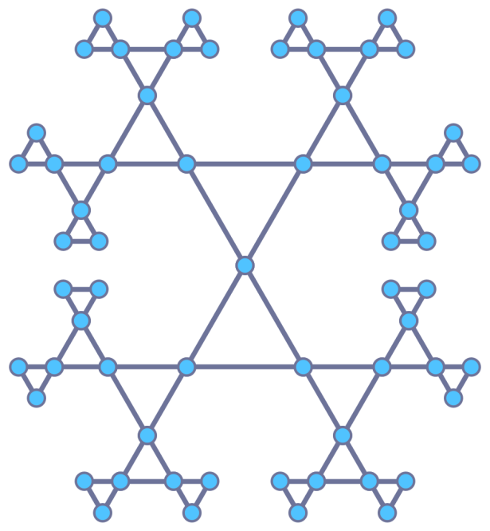
Husimi is dreamy
???
The Husimi Cactus is locally the same, but loopless!
Should capture “local” physics
Coplanar order, spin disorder, VBS states
Will miss “loop” physics
Coloring selection, spin-loop tunneling, spin liquid flux patterns
R=0
4
1
2
3

Slide 7
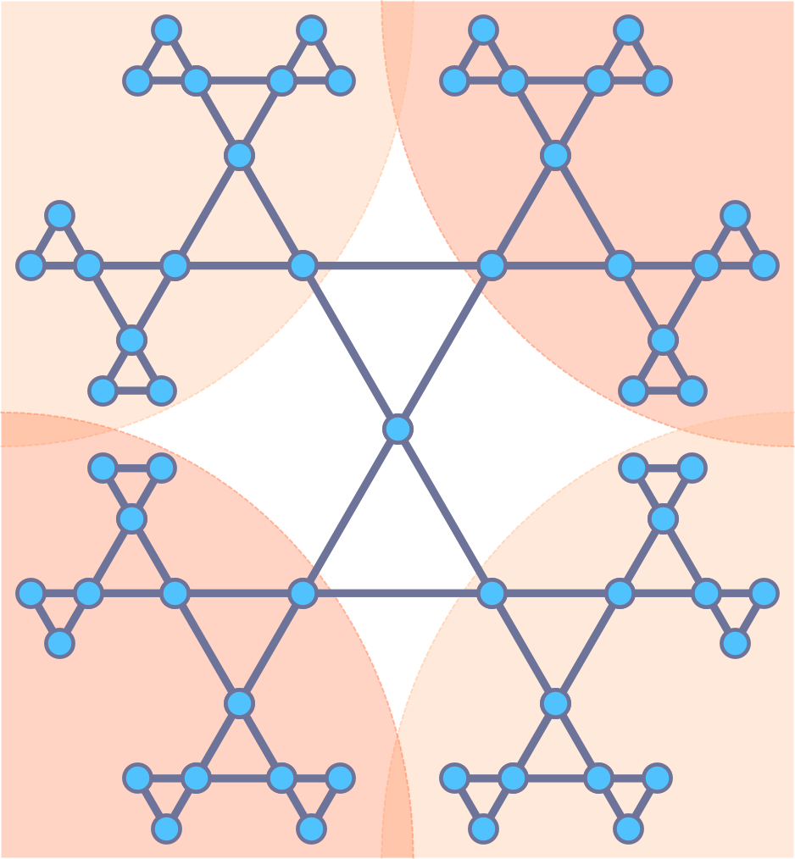
Husimi is dreamy
???
O(m⁴) infinite DMRG algorithm:
Largest simulations: 210000 sites, 20 – 30 kept states
m₃
m₄
m₁
m₂

Slide 8
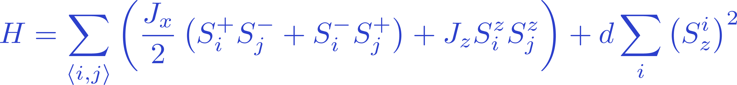
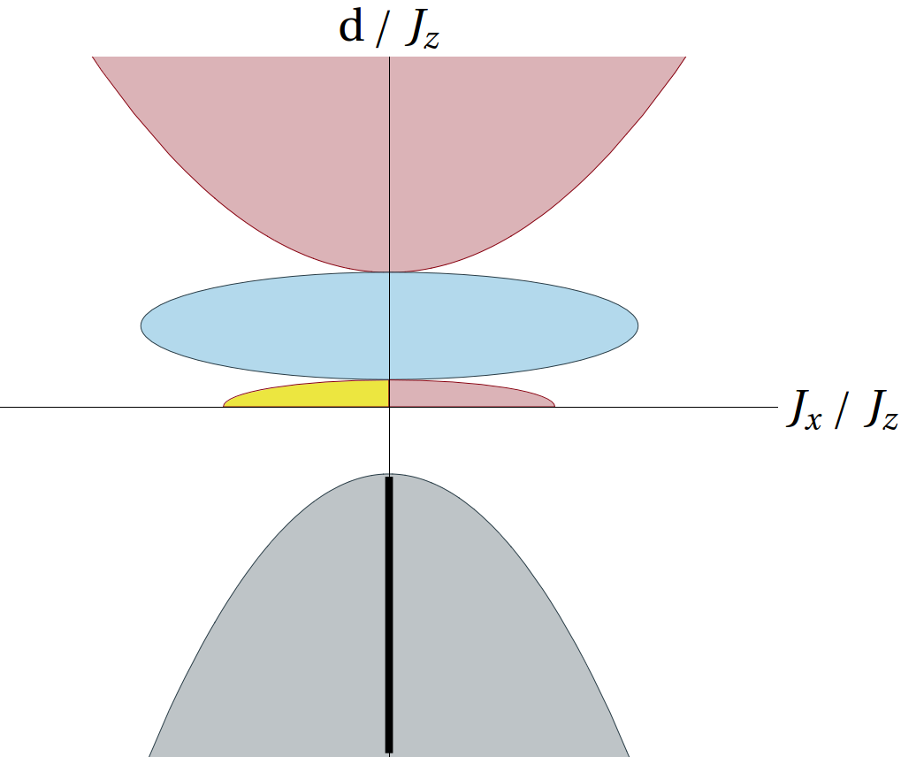

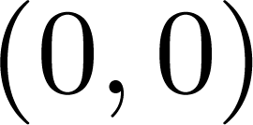



“Large” spin results
???
Slow down, enjoy the view
Proposed phase diagram (based on Kagome)
Heisenberg Anisotropy
On-site easy axis anisotropy
XY Ferromagnet
Quantum Paramagnet
120° States (isotropic, planar)
Hex VBS analog?
Triangle VBS
Disorder
Nematic

Slide 9
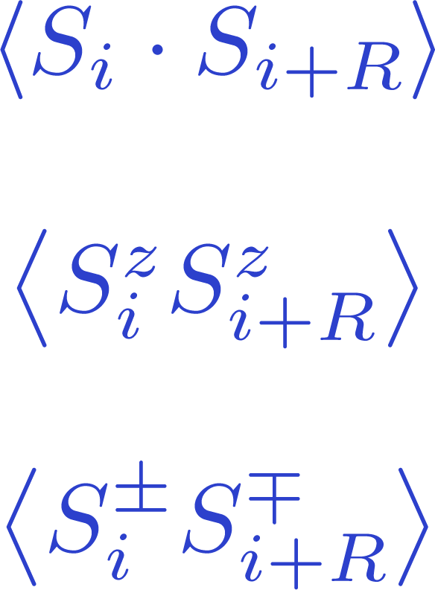
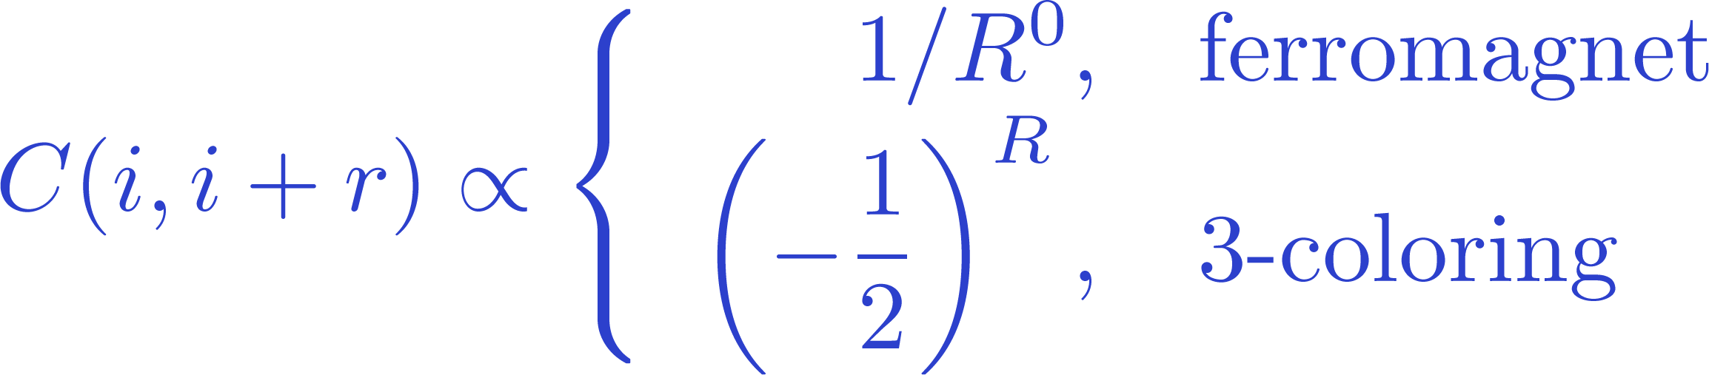
“Large” spin results
???
Our primary diagnostic tools are spin-spin correlations
R=0
4
1
2
3

Slide 10
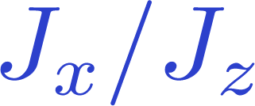
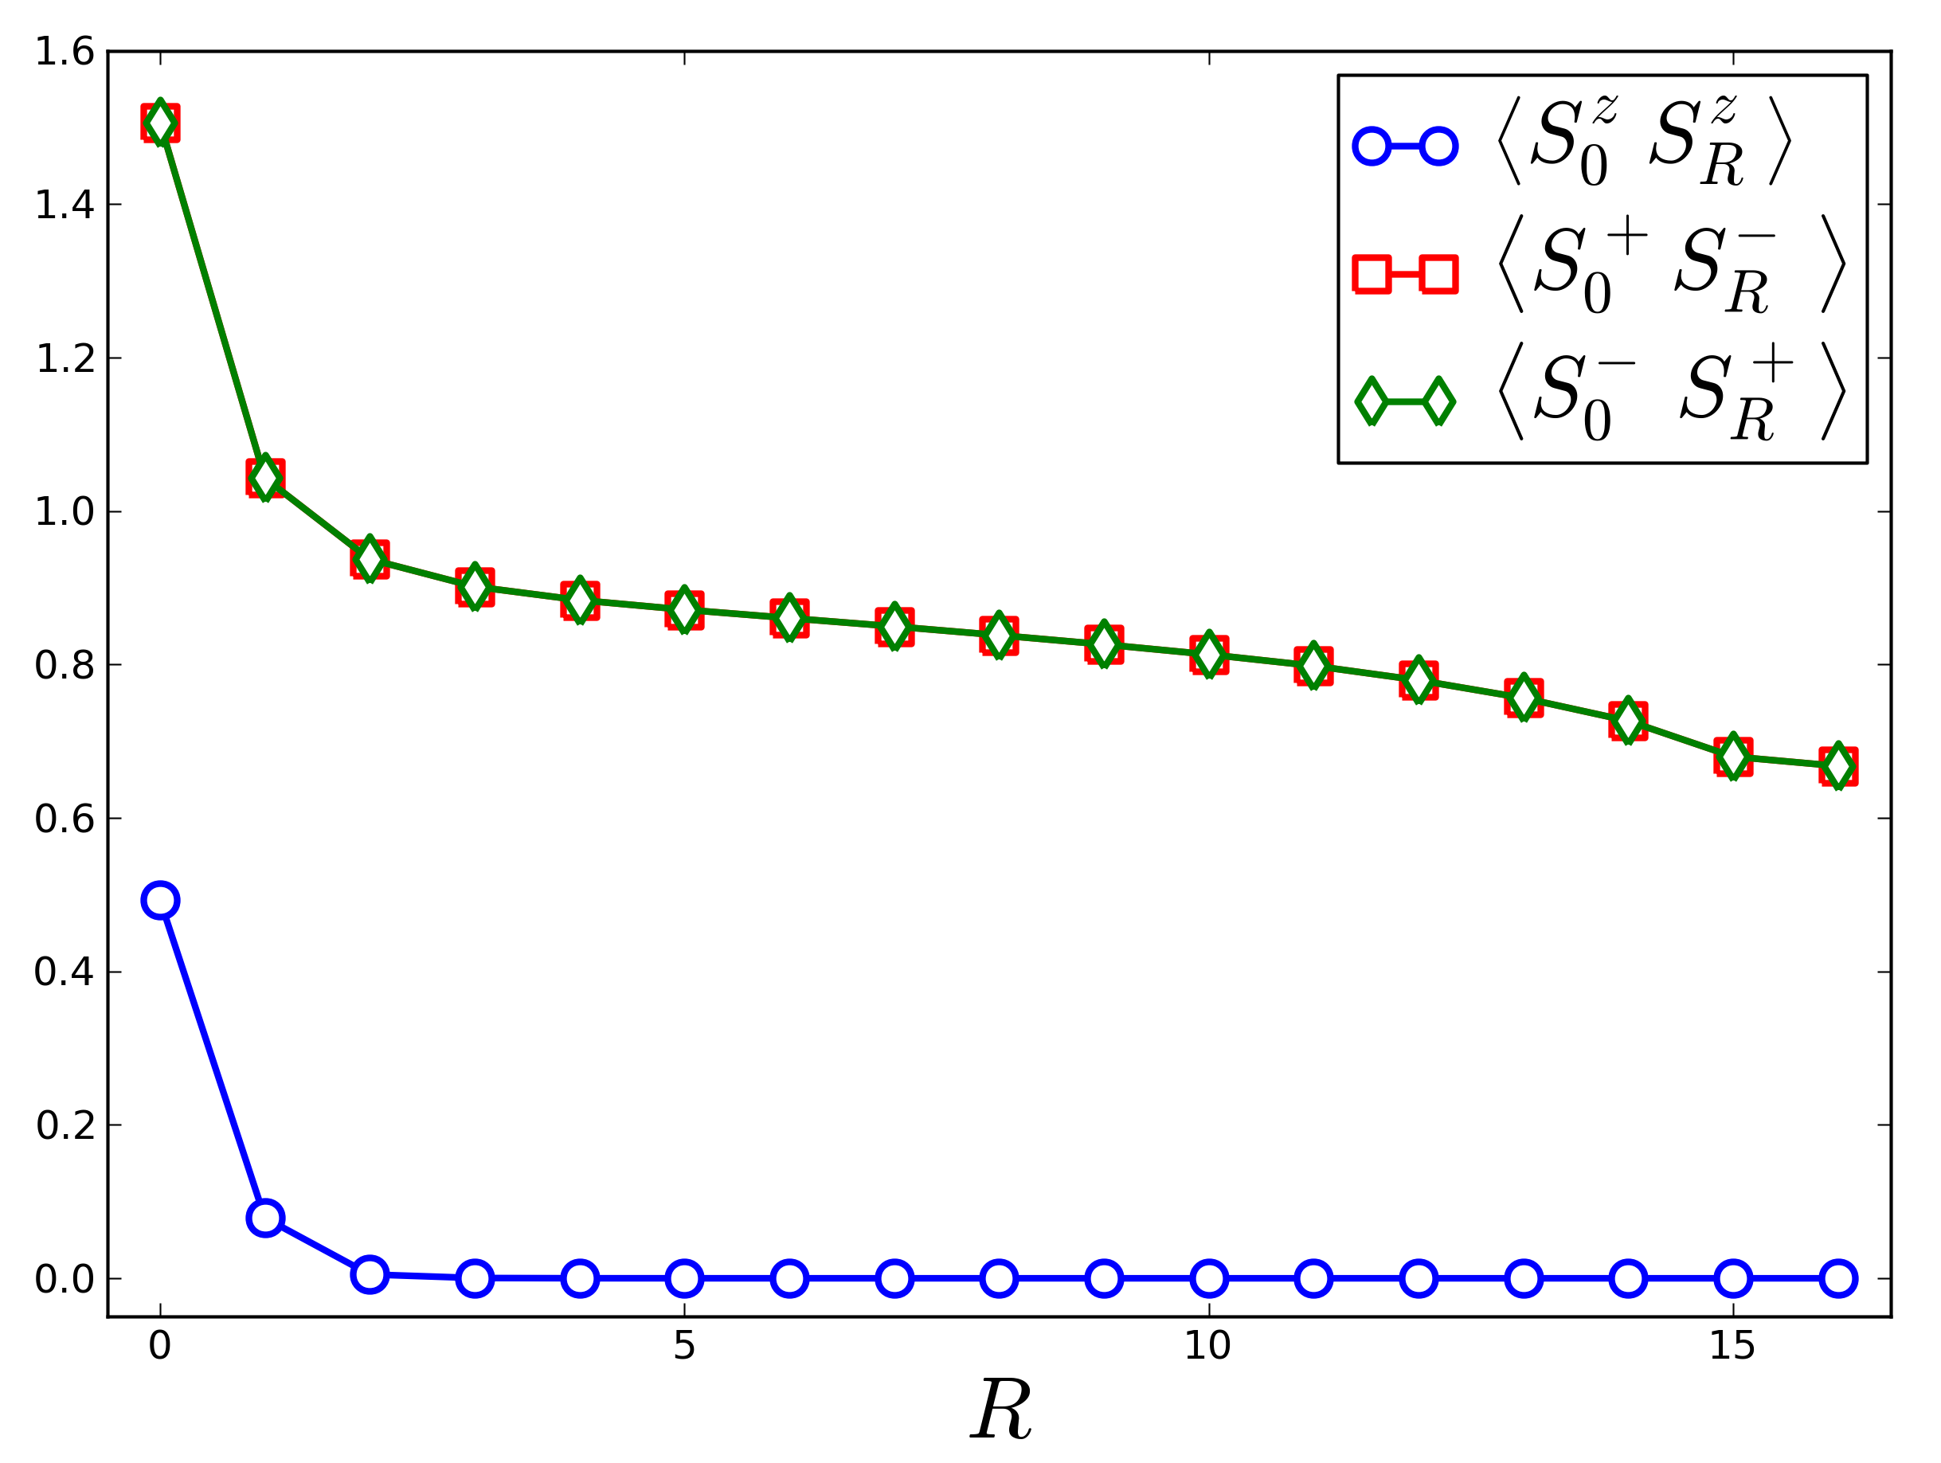

“Large” spin results
???
Test case: XY Ferromagnet ( large and negative)
-axis correlation decay to zero rapidly
In-plane correlations decay to a non-zero constant

Slide 11
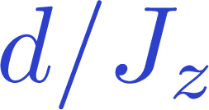
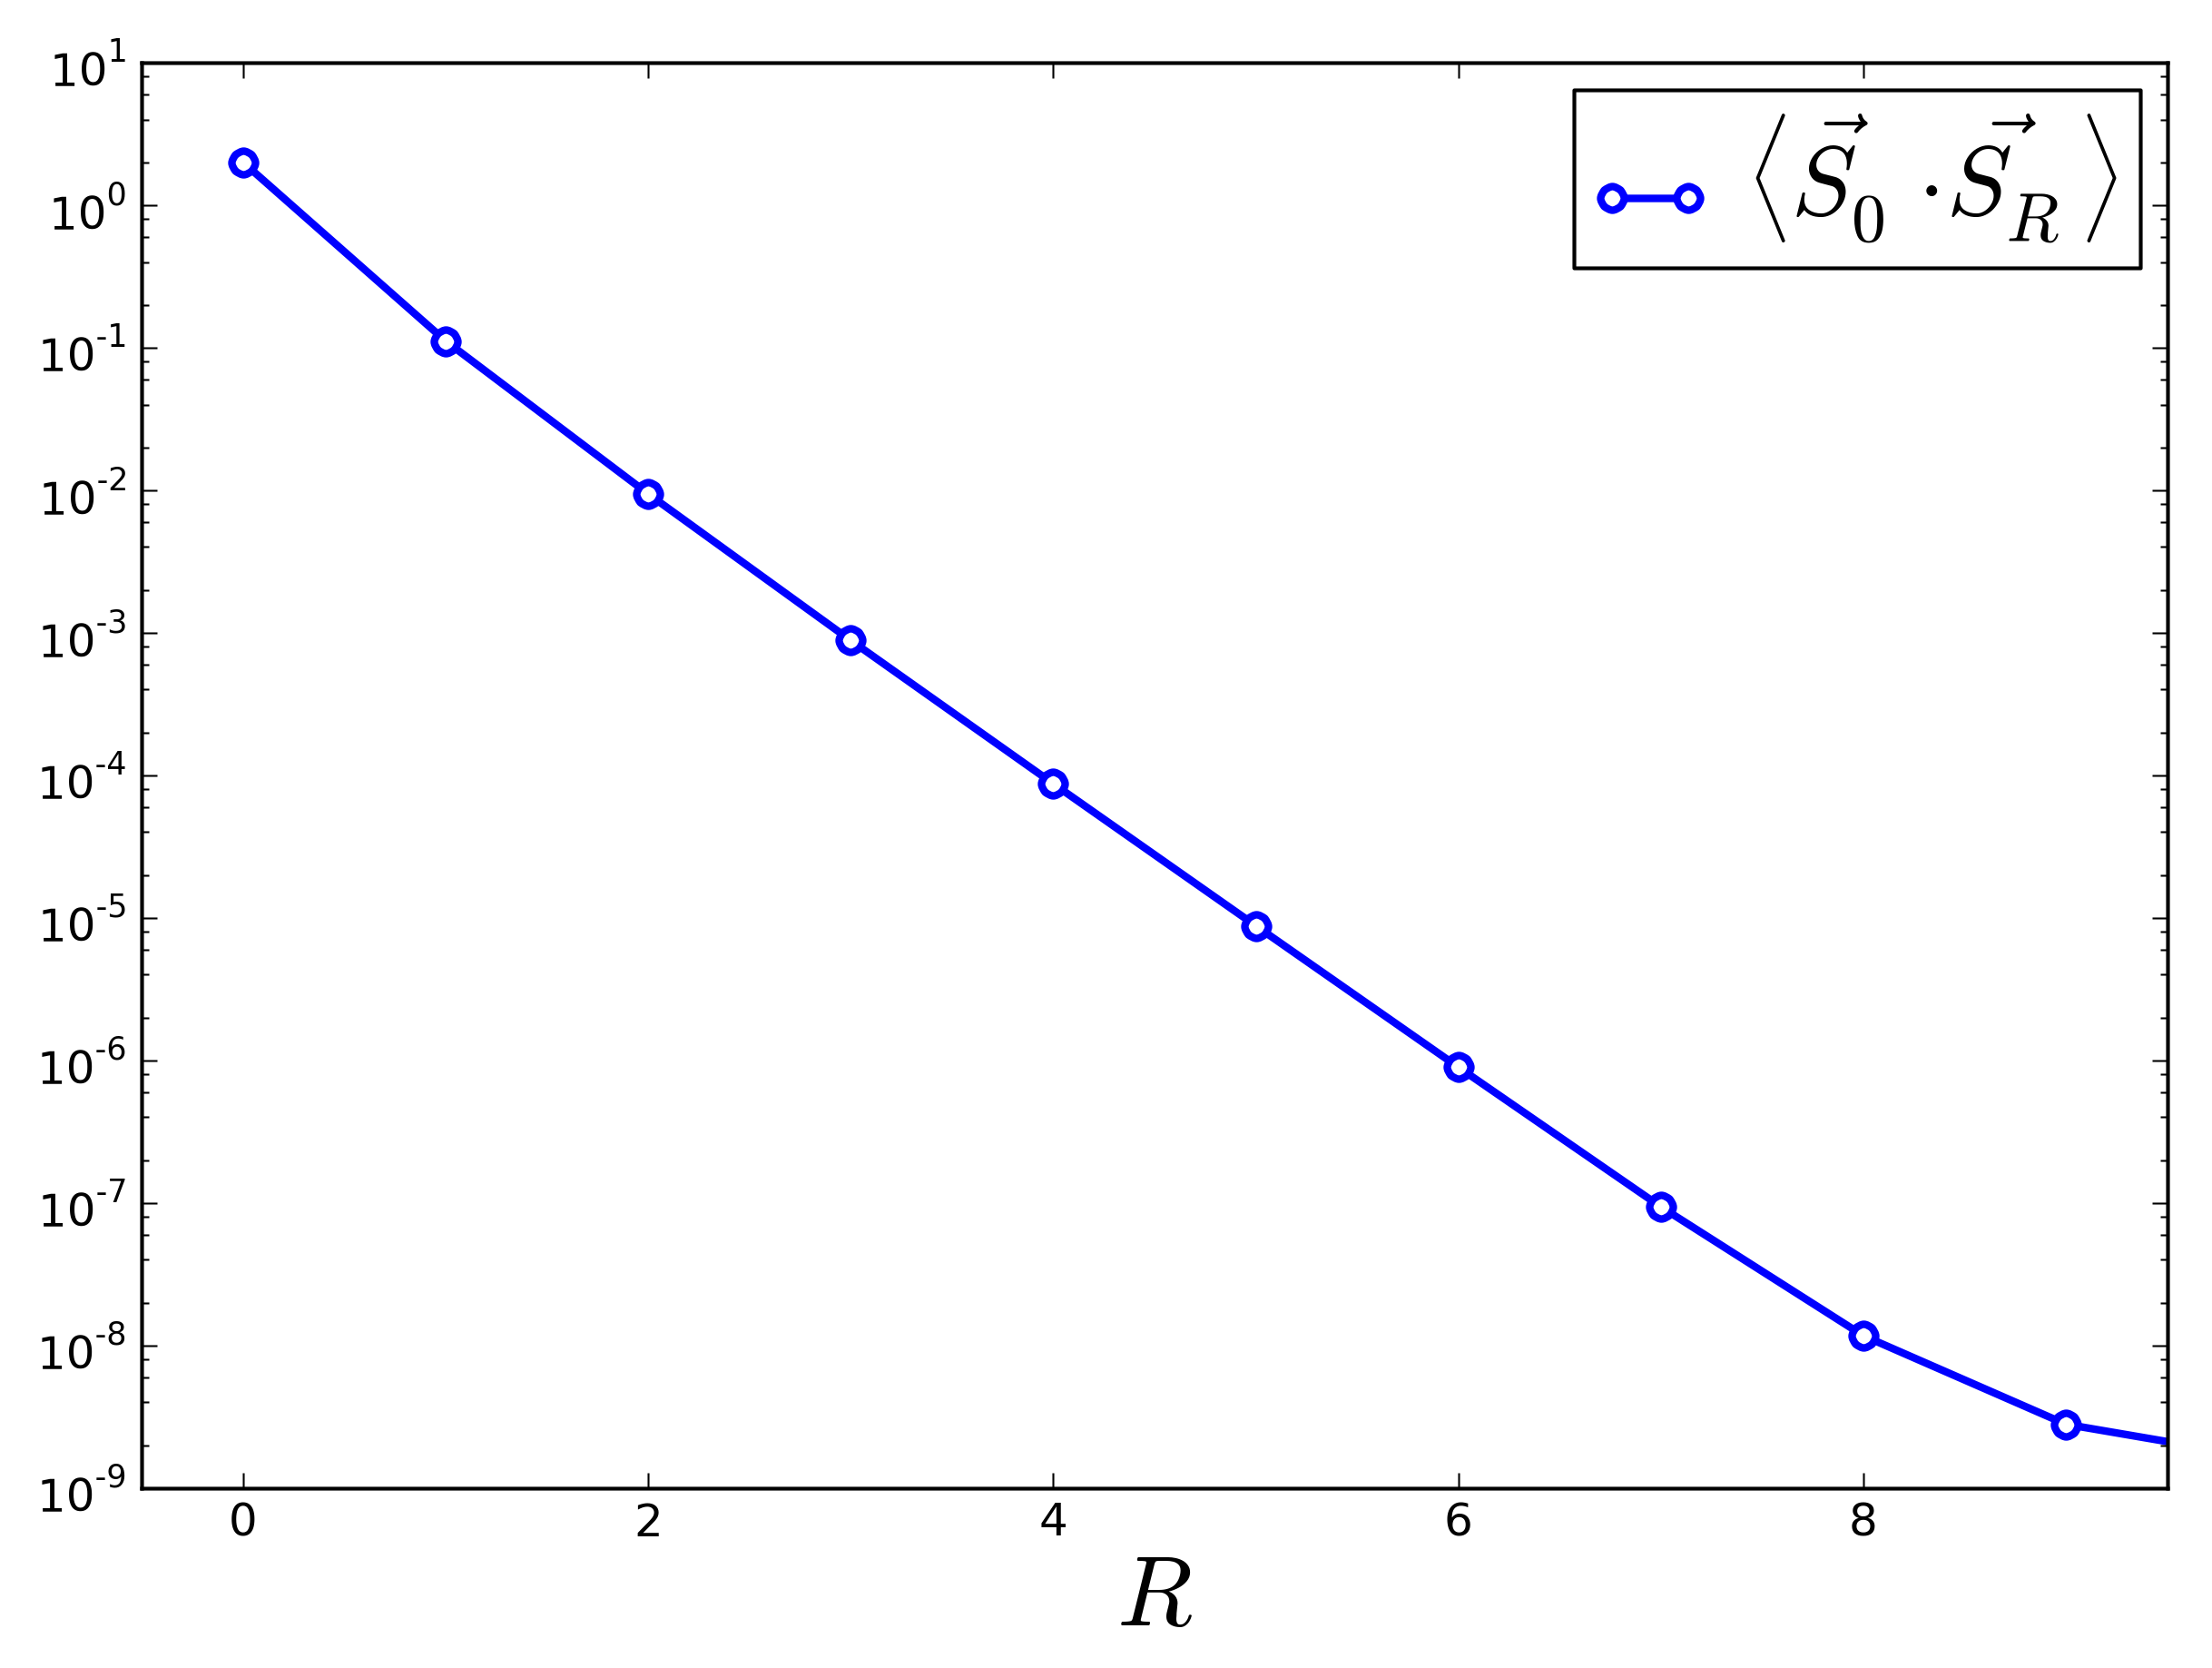
“Large” spin results
???
Disordered quantum paramagnet (large )
Exponentially decaying spin-spin correlations, as expected

Slide 12
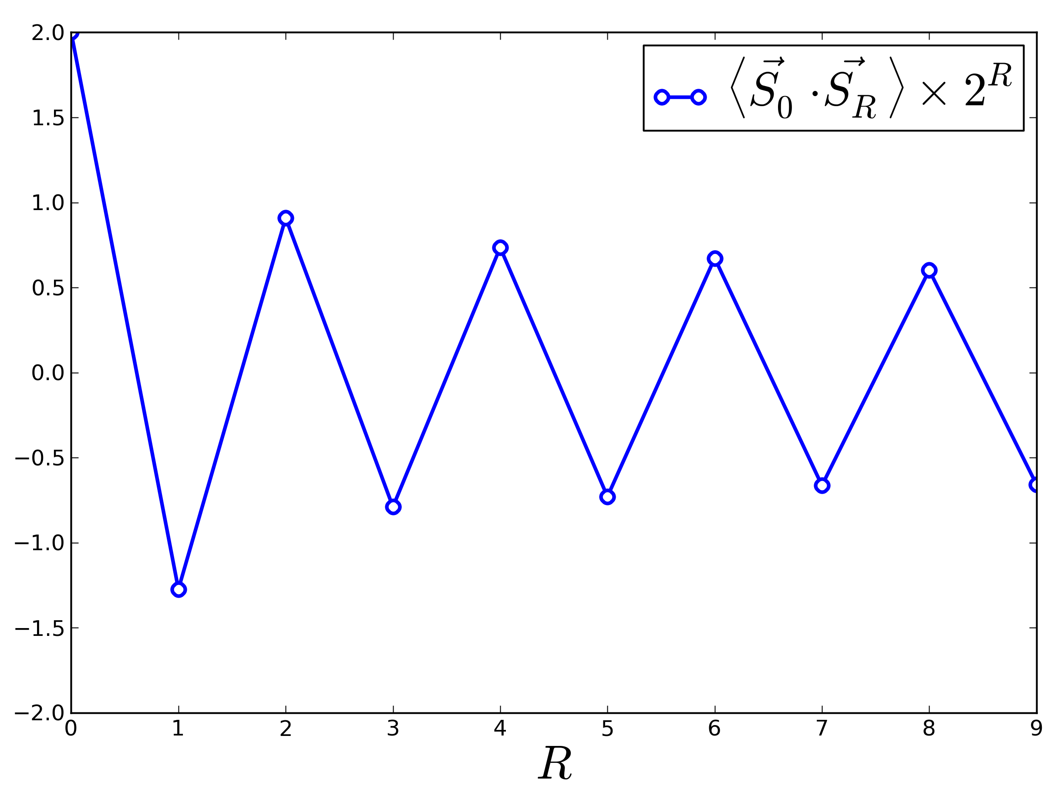
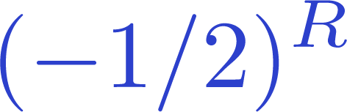
“Large” spin results
???
120-degree states and 3-color ordering
The closer the decay is to , the closer the state is to being 3-color-ordered

Slide 13


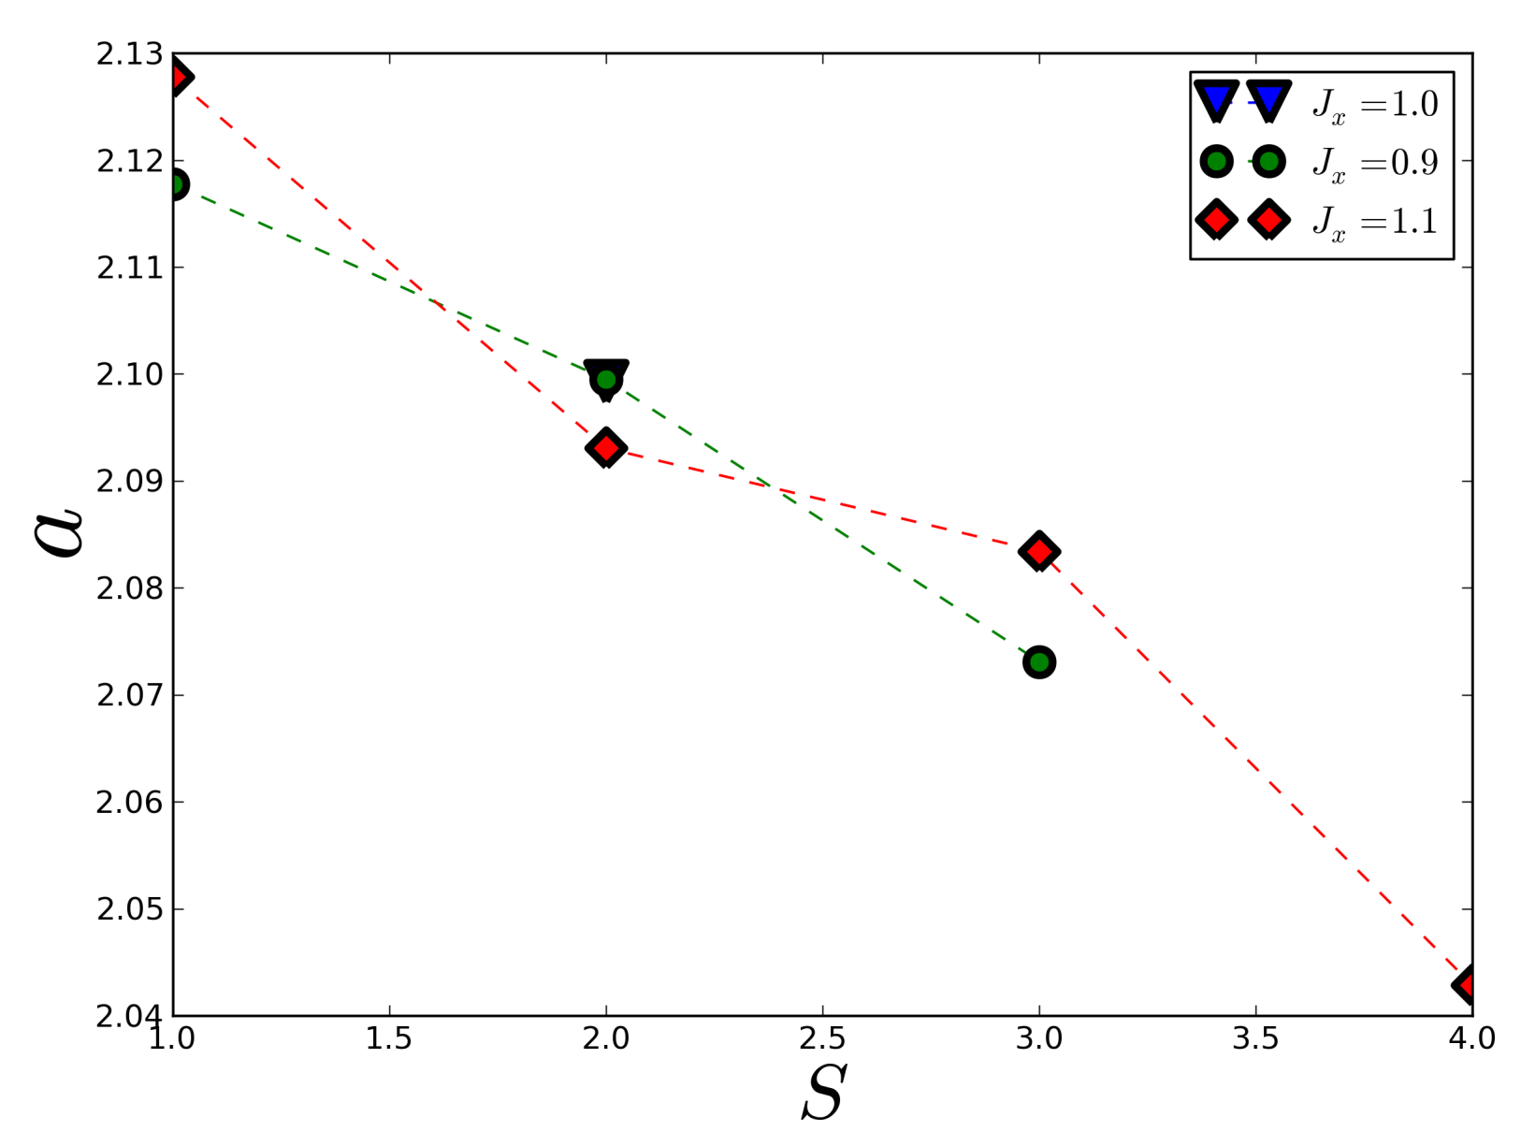
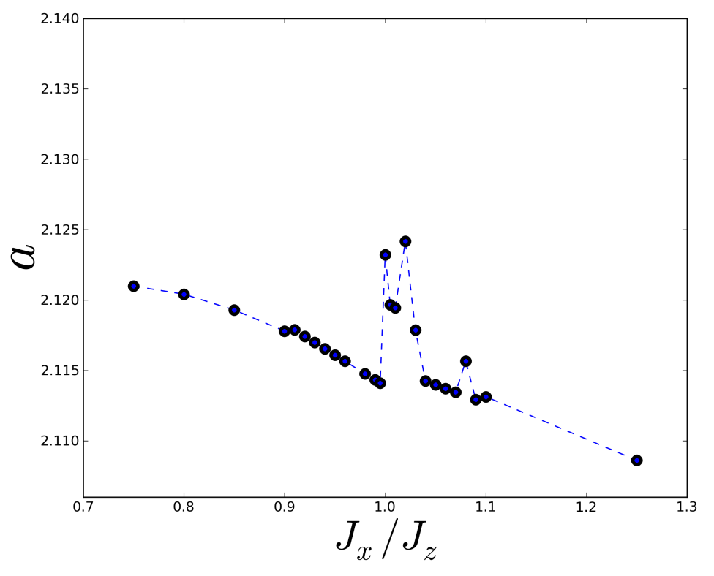
“Large” spin results
???
Scaling at the Isotropic Point for
Qualitative agreement for larger S values
Some difficulties near the Isotropic Heisenberg point

